Slide 1

UNDERSTANDING THE LEGAL RISKS ASSOCIATED WITH
LARGE WOOD PLACEMENTS AND ENGINEERED LOG JAMS
David K. Eckberg

Slide 2
Introduction/Background
Fish & Wildlife Protection & Enhancement
Unintended Consequences
Increased Awareness

Slide 3
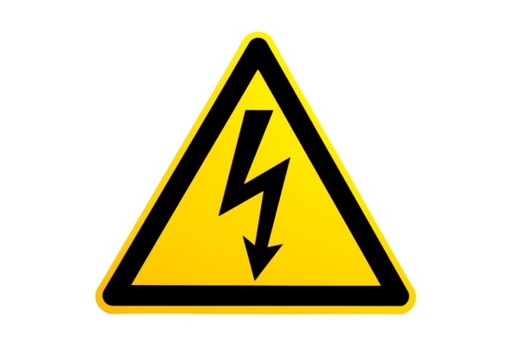
What are the Risks?
Health and Safety During Construction
Hazards to River Users
Hazards to Children
Flooding of Upstream Properties
Erosion and Damage to Downstream Properties
Personal Injury and Property Damage when all or Part of ELJ or LWP Breaks Free

Slide 4
Who are the Potential Injured Parties?
Construction Workers/Field Personnel
River Users
Children
Upstream Private Property Owners
Downstream Private Property Owners
Public Landowners
Natural Environment

Slide 5
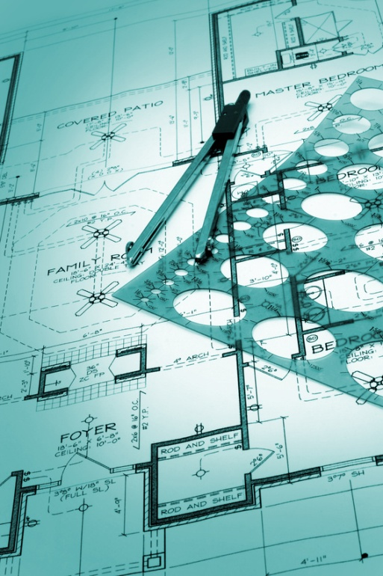
Who are the Potential Liable Parties?
Designers
Contractors
Landowners Where ELJ or LWP is Located
Project Sponsors

Slide 6
Legal Principals
Health & Safety Standards
Negligence
Recreational Use Immunity
Attractive Nuisance
Natural Watercourse Rule
Environmental Laws

Slide 7
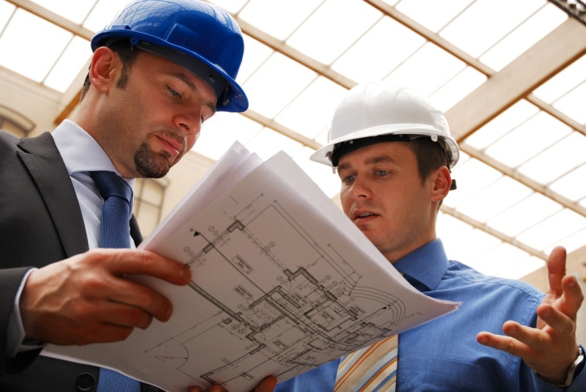
Health & Safety Standards
All employers are required to maintain a safe workplace for their employees.
      RCW 49.17.060(1)
Assess Site Conditions
Site Safety Plans

Slide 8
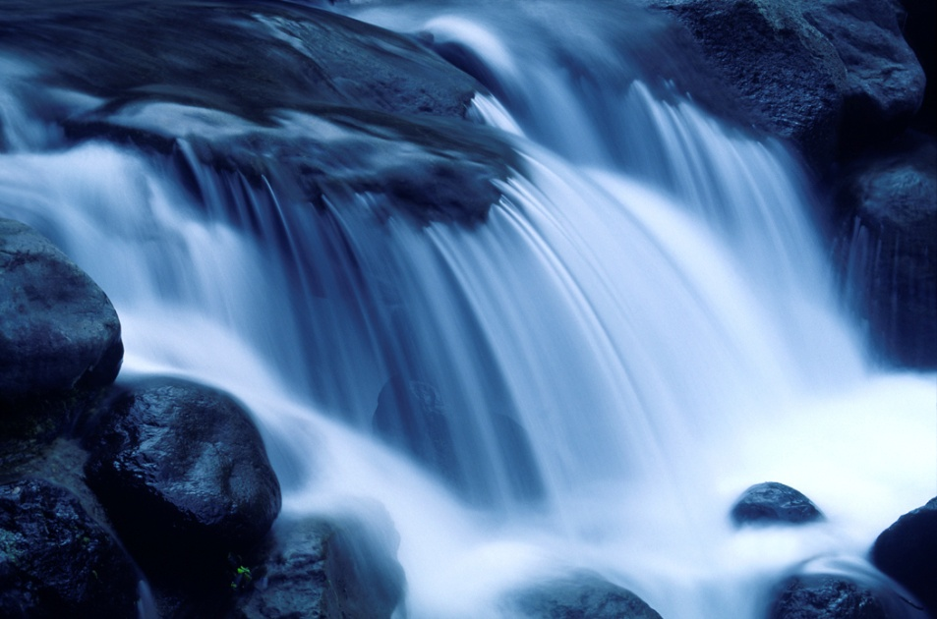
Negligence
In the Design
In the Construction
Need for Licensed Engineer?
How Extensive Should Modeling Be?
Ultimately a Standard of Care Question

Slide 9
Recreational Use Immunity
RCW 4.24.210:
(1) Except as otherwise provided in subsection (3) or (4) of this section, any public or private landowners or others in lawful possession and control of any lands whether designated resource, rural, or urban, or water areas or channels and lands adjacent to such areas or channels, who allow members of the public to use them for the purposes of outdoor recreation, which term includes, but is not limited to, . . . fishing, camping, picnicking, swimming, hiking, . . . clam digging, . . . boating, nature study, winter or water sports, viewing or enjoying historical, archaeological, scenic, or scientific sites, without charging a fee of any kind therefore, shall not be liable for unintentional injuries to such users.

Slide 10
Recreational Use Immunity (cont.)
RCW 4.24.210:
…
(2) Except as otherwise provided in subsection (3) or (4) of this section, any public or private landowner or others in lawful possession and control of any lands whether rural or urban, or water areas or channels and lands adjacent to such areas or channels, who offer or allow such land to be used for purposes of a fish or wildlife cooperative project, or allow access to such land for cleanup of litter or other solid waste, shall not be liable for unintentional injuries to any volunteer group or to any other users. . . .
…

Slide 11
Recreational Use Immunity (cont.)
RCW 4.24.210:
…
(4) Nothing in this section shall prevent the liability of a landowner or others in lawful possession and control for injuries sustained to users by reason of a known dangerous artificial latent condition for which warning signs have not been conspicuously posted. . . . Nothing in RCW 4.24.200 and this section limits or expands in any way the doctrine of attractive nuisance. . . .

Slide 12
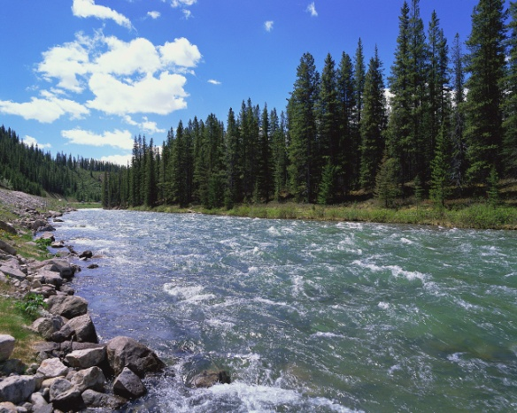
Known, Dangerous, Artificial, Latent Condition
Known
    Actual knowledge by landowner
Dangerous
    Unreasonable risk of harm
Artificial
    Man Made
Latent
    Not Readily Apparent
Fish & Wildlife Cooperative Projects

Slide 13
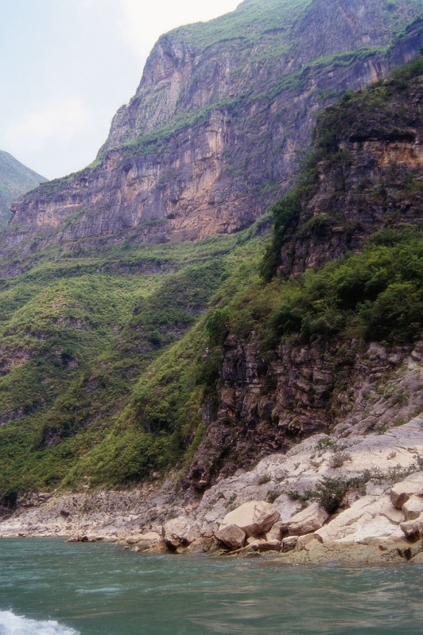
In Perspective
Immunity Only for Landowner
Need for Warning Signs

Slide 14
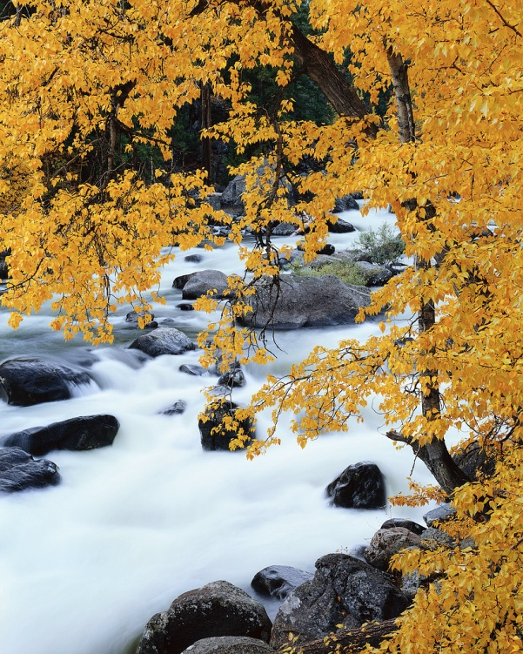
Attractive Nuisance
Must be Dangerous
Must be Attracting/Alluring
Child Incapable of Comprehending Danger
Condition Left Unguarded
Reasonable to Prevent Access
  Without Obstructing Purpose

Slide 15
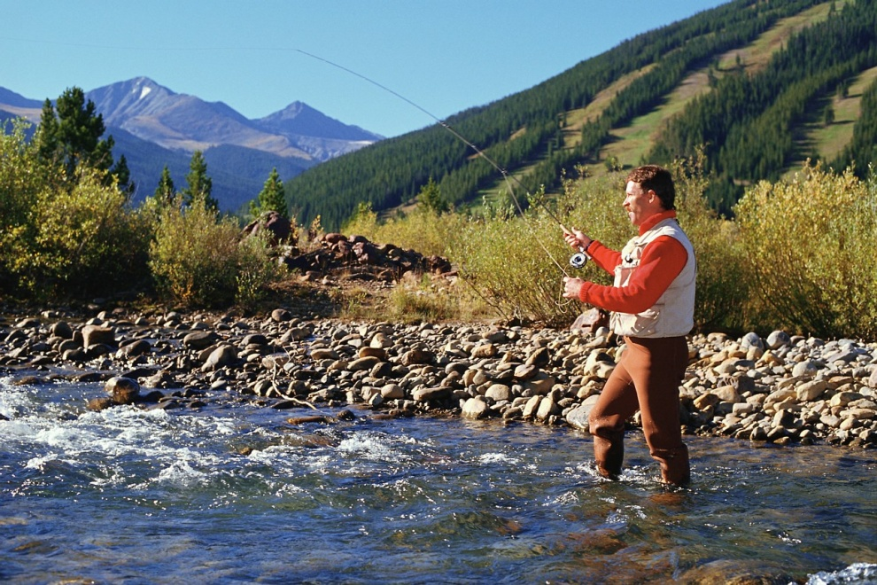
Natural Watercourse Rule
Early 1990’s
Entitled to Allow Stream to Flow in Natural Watercourse Next to Land
“Natural” means time when right is exercised
Subject to Appropriation Water Rights

Slide 16
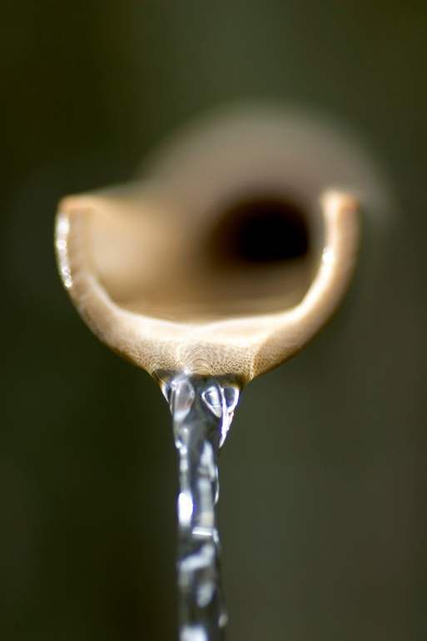
Environmental Laws
NEPA/SEPA
Clean Water Act
Critical Areas
Flood Plain Restrictions
Local Laws

Slide 17

Mitigating the Risk
Quality Design/Construction Team
Planning for Health & Safety Risks
Warnings! Warnings! Warnings!
    In Specifications
    Signs on River
    Affected Landowners

Slide 18
Mitigating the Risk
Opportunities to Avoid ELJ or LWP
Monitoring Maintenance & Repair
Contractual Risk Allocation

Slide 19

One Convention Place, 701 Pike Street, Suite 1400, Seattle, WA 98101

