Slide 1
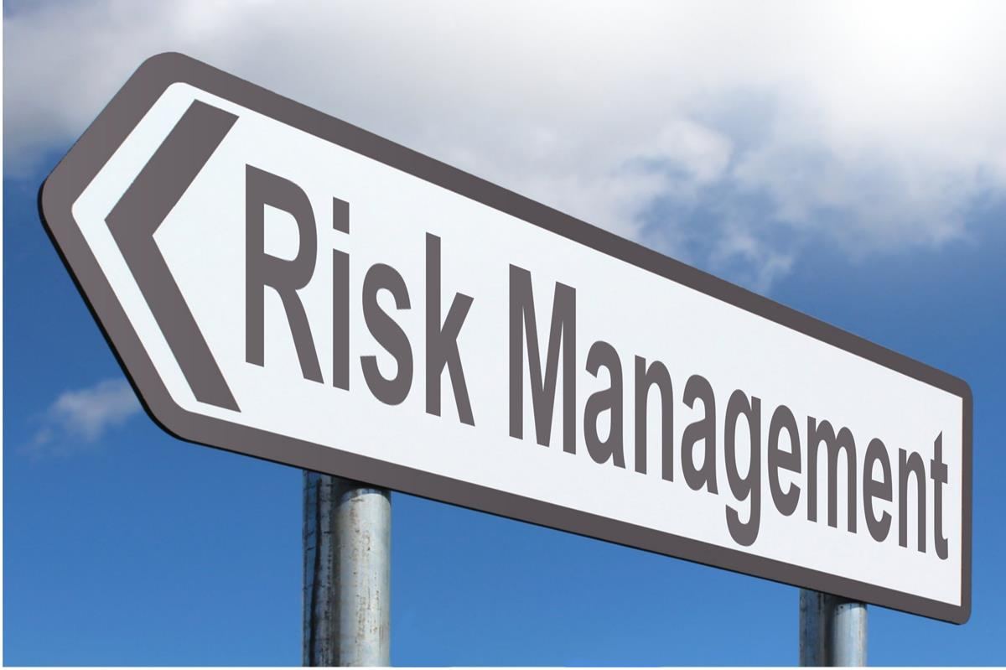

RISK MANAGEMENT THROUGH CONTRACT
Risk and Insurance Management Society, Inc.
This Photo by Unknown Author is licensed under CC BY-SA

Slide 2
INTRODUCTION
The enhanced role of the CONTRACT in the current economic climate
What we will cover:
  Contract Basics
  Common Contract Types
  Understanding the Risks
  Risk Transfer Clauses
  Other Important Clauses
  Insurance Provisions
  Negotiating Tips

Slide 3
CONTRACT BASICS
Offer and Acceptance
  The battle of the forms
  Rejection and counteroffer
  Electronic Authorization
  Electronic Signature

Slide 4

CONTRACT BASICS
Unenforceable Agreements
  Void as against public policy
  Unconscionable
  Statute of frauds
Use of the UCC
  Commercial transactions

Slide 5
TYPICAL CONTRACT TYPES
Vendor Agreements
Licensing Agreements
Purchase Orders
Professional Services Agreements
Construction Contracts
Lease Agreements
Purchase and Sale Agreements
Joint Venture Arrangement

Slide 6

UNDERSTANDING THE RISKS
What are the real risks?
Important to identify
Contract terms need to address

Slide 7

UNDERSTANDING THE RISKS
How to protect against these risks in Contract
  Indemnity
  Insurance
  Responsibility allocation
  Limitation of Liability
  Control over claim resolution

Slide 8
UNDERSTANDING THE RISKS
Example risks:
  Personal injury
  Property damage
  Economic loss
  Infringement
  Environmental
  Business interruption
  Interference with business
  Delays

Slide 9
SIGNIFICANT RISK
TRANSFER CLAUSES
Indemnity
Duty to defend
Duty to hold harmless
Anti-indemnity statute
  Limitation of Liability
Reasonable amount
Only applies to parties in contract
Opportunity to negotiate

Slide 10
SIGNIFICANT RISK
TRANSFER CLAUSES
Warranties
Express (in contract)
Implied
Time Bar to Legal Action/Disputes Resolution
Controls and minimizes costs of claims resolution
Responsibilities of Parties

Slide 11
OTHER IMPORTANT
CONTRACT CLAUSES
Payment
Termination
Changes
Severability and Survival
Term
Assignment/Subletting/Subcontracting
Jurisdiction and Venue
Prohibited Uses/Acts
Delays

Slide 12
EVALUATING/DRAFTING INSURANCE PROVISIONS
What are the significant risks requiring coverage?
  Errors and omissions?
  Property damage?
  Accidents on site?
  Fire/casualty?
  Etc.

Slide 13

EVALUATING/DRAFTING INSURANCE PROVISIONS
Types of Insurance
  General Liability
  Property
  Automobile
  Environmental
  Professional
Limits and Endorsements
Waivers of Subrogation
Additional Insureds
Certificates

Slide 14

NEGOTIATING TIPS
Know your leverage
Get to the “right” level
Appeal to Concepts of Fairness
Move “up the chain” as necessary
Question “company policies”
Always be prepared to offer alternatives
Know the “walk away” issues
Negotiate with attitude that agreement will occur

Slide 15

One Convention Place, 701 Pike Street, Suite 1400, Seattle, WA 98101

