Slide 1
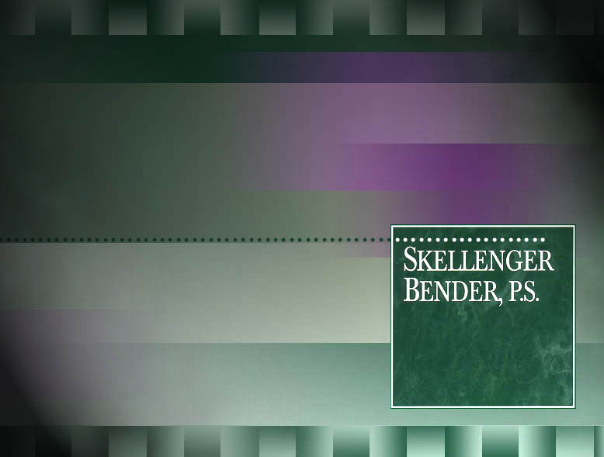

NUTS AND BOLTS
ON
CONTRACTS AND INSURANCE
David K. Eckberg
© 2018 – 2021 David K. Eckberg, Betts, Patterson & Mines, P.S.
Disclaimer: Legal information is not legal advice
Notes:
Notes:

Slide 2
I. INTRODUCTION
Key Tools for Preventing Loss
i. Relationships
ii. Communication
iii. Contracts
iv. Insurance
Focus Today—Contracts and Insurance
© 2018 – 2021 David K. Eckberg, Betts, Patterson & Mines, P.S.
Disclaimer: Legal information is not legal advice

Slide 3

II. CONTRACT BASICS
a. Offer
i. Normally a proposal containing scope and cost with terms
ii. Response to solicitation
b. Acceptance
i. Must “Mirror” the offer
ii. Formed at time last party signs agreement
iii. Acceptance by conduct
© 2018 – 2021 David K. Eckberg, Betts, Patterson & Mines, P.S.
Disclaimer: Legal information is not legal advice

Slide 4
II. CONTRACT BASICS
c. Counteroffer v. Acceptance
i. Signed with changes
ii. Signed with new terms attached
d. Scenarios
© 2018 – 2021 David K. Eckberg, Betts, Patterson & Mines, P.S.
Disclaimer: Legal information is not legal advice

Slide 5
II. CONTRACT BASICS
e. Last Resorts
i. Faxed “signature page”
ii. Confirmation letters
f. Changes or Amendments to Original Contract
© 2018 – 2021 David K. Eckberg, Betts, Patterson & Mines, P.S.
Disclaimer: Legal information is not legal advice

Slide 6
III. PRIMARY CAUSES OF ACTION
a. Professional Negligence
i. Is There a Duty or Standard of Care Owed?
(Reasonably Foreseeable Plaintiff)
Economic Loss Doctrine
© 2018 – 2021 David K. Eckberg, Betts, Patterson & Mines, P.S.
Disclaimer: Legal information is not legal advice

Slide 7
III. PRIMARY CAUSES OF ACTION
ii. Duty or Standard of Care Defined:
What a reasonable professional engineer would have done at that time under those circumstances within that locale
iii.Was there a Breach of the Duty?
Expert testimony by person practicing in profession
New All Appropriate Inquiry Rules
© 2018 – 2021 David K. Eckberg, Betts, Patterson & Mines, P.S.
Disclaimer: Legal information is not legal advice

Slide 8
III. PRIMARY CAUSES OF ACTION
iv. Did the Breach Proximately Cause Damages
Reasonably foreseeable
Negligent Misrepresentation
Breach of Contract
© 2018 – 2021 David K. Eckberg, Betts, Patterson & Mines, P.S.
Disclaimer: Legal information is not legal advice

Slide 9
III. PRIMARY CAUSES OF ACTION
d. Breach of Warranty
i. implied warranties regarding design
ii. expressly disclaim warranties
e. Strict Liability
i. Superfund type
ii. Ultra-Hazardous Activity
© 2018 – 2021 David K. Eckberg, Betts, Patterson & Mines, P.S.
Disclaimer: Legal information is not legal advice

Slide 10
IV. KEY LANDAU CONTRACT TERMS
a. Limitation of Liability
i. Only with Client
ii. Applies to all claims, including negligence
iii. Means of balancing risk
iv. Important to allow for negotiation
v. Opportunity to increase fee for any increased risk
vi. Enforceable in Washington
© 2018 – 2021 David K. Eckberg, Betts, Patterson & Mines, P.S.
Disclaimer: Legal information is not legal advice

Slide 11
IV. KEY LANDAU CONTRACT TERMS
b. Indemnification
i. One party steps in the shoes of another party and agrees to defend and pay for claims
ii. Requires Client to indemnify Landau for “pollution or contamination” related claims, unless Landau is negligent
© 2018 – 2021 David K. Eckberg, Betts, Patterson & Mines, P.S.
Disclaimer: Legal information is not legal advice

Slide 12
IV. KEY LANDAU CONTRACT TERMS
iii. Washington anti-indemnity statute prohibits one party from indemnifying another party for that party’s negligence in most circumstances relating to Landau work.
© 2018 – 2021 David K. Eckberg, Betts, Patterson & Mines, P.S.
Disclaimer: Legal information is not legal advice

Slide 13
IV. KEY LANDAU CONTRACT TERMS
iv. Client contracts
- typically requires Landau to indemnify Client beyond fault or negligence of Landau
- assume defense of actions
- see insurance coverage
- goal to limit to negligence of Landau
© 2018 – 2021 David K. Eckberg, Betts, Patterson & Mines, P.S.
Disclaimer: Legal information is not legal advice

Slide 14
IV. KEY LANDAU CONTRACT TERMS
c. Time Bar
i. Two years after completion of services
ii. Effective deterrent to lawsuits
iii. Normally 6 years after substantial completion of the project (not completion of Landau work)
iv. Client contracts—extend time period?
© 2018 – 2021 David K. Eckberg, Betts, Patterson & Mines, P.S.
Disclaimer: Legal information is not legal advice

Slide 15
V. SUBCONTRACTS
Vicarious Responsibility for acts of subs
b. Two types of Subcontracts for Landau:
i. Contractors
ii. Consultants, Engineers and other Professionals
iii. Important to finalize and execute the agreement
© 2018 – 2021 David K. Eckberg, Betts, Patterson & Mines, P.S.
Disclaimer: Legal information is not legal advice

Slide 16
VI. LANDAU CURRENT INSURANCE PROGRAM
a. Commercial general liability vs. professional liability (certificates of insurance, Additional Insured).
b. How to respond to a request to increase the firm's professional liability limits.
© 2018 – 2021 David K. Eckberg, Betts, Patterson & Mines, P.S.
Disclaimer: Legal information is not legal advice

Slide 17
VI. LANDAU CURRENT INSURANCE PROGRAM
c. What does professional liability cover?
i. Breach of professional duty.
ii. Bodily injury, property damage or environmental damage caused by pollution conditions.
© 2018 – 2021 David K. Eckberg, Betts, Patterson & Mines, P.S.
Disclaimer: Legal information is not legal advice

Slide 18
VI. LANDAU CURRENT INSURANCE PROGRAM
d. "Limited " contractual liability insurance
There is no insurance for the liability of others assumed by any Insured under any contract or agreement except this exclusion does not apply to liability:
© 2018 – 2021 David K. Eckberg, Betts, Patterson & Mines, P.S.
Disclaimer: Legal information is not legal advice

Slide 19
VI. LANDAU CURRENT INSURANCE PROGRAM
i. for a breach of professional duty in the rendering or failure to render professional services to others by the Insured or for which the Insured is legally liable as the result of the performance of others.
ii. that the Insured would have in the absence of the contract or agreement.
© 2018 – 2021 David K. Eckberg, Betts, Patterson & Mines, P.S.
Disclaimer: Legal information is not legal advice

Slide 20
VI. LANDAU CURRENT INSURANCE PROGRAM
e. Red Flags
- Warranties, guarantees
- Highest standard of care, best, other superlatives
- Landau will be responsible for any and all acts except Owner's sole negligence
- Assumption of defense
© 2018 – 2021 David K. Eckberg, Betts, Patterson & Mines, P.S.
Disclaimer: Legal information is not legal advice

Slide 21
VII. CLAIM AVOIDANCE
a. Relationships—The Cornerstone to Loss Prevention
i. Client selection
ii. Project selection
iii. Project team, including Contractors and Subcontractors
iv. Build trust
© 2018 – 2021 David K. Eckberg, Betts, Patterson & Mines, P.S.
Disclaimer: Legal information is not legal advice

Slide 22
VII. CLAIM AVOIDANCE
b. Communication
i. Continuous v. sporadic
ii. Documentation
iii. Proper wording in reports and correspondence
iv. Use of e-mails
© 2018 – 2021 David K. Eckberg, Betts, Patterson & Mines, P.S.
Disclaimer: Legal information is not legal advice

Slide 23
VII. CLAIM AVOIDANCE
c. Signed Contracts
i. acceptable terms and conditions
ii. scoping and pricing
iii. understanding contract and roles/responsibilities
d. Insurance
© 2018 – 2021 David K. Eckberg, Betts, Patterson & Mines, P.S.
Disclaimer: Legal information is not legal advice

Slide 24
VIII. CASE HISTORIES
© 2018 – 2021 David K. Eckberg, Betts, Patterson & Mines, P.S.
Disclaimer: Legal information is not legal advice

Slide 25

One Convention Place, 701 Pike Street, Suite 1400, Seattle, WA 98101
© 2018 – 2021 David K. Eckberg, Betts, Patterson & Mines, P.S.
Disclaimer: Legal information is not legal advice

