Slide 1
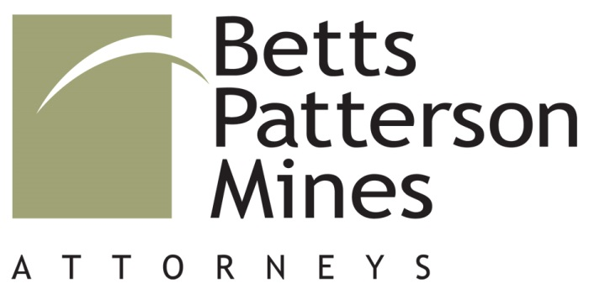
THE LIABILITY OF DESIGN PROFESSIONALS
DAVID ECKBERG
© 2018 – 2021 David K. Eckberg, Betts, Patterson & Mines, P.S.
Disclaimer: Legal information is not legal advice

Slide 2

INTRODUCTION
Background​
Liability in Contract​
Liability in Tort​
Differences between Contractor Liability and Design Professional Liability​
Tips for Minimizing Claims​
Closing Remarks
© 2018 – 2021 David K. Eckberg, Betts, Patterson & Mines, P.S.
Disclaimer: Legal information is not legal advice

Slide 3

BACKGROUND
The Changing Landscape of Construction Projects​
  traditional contracting​
  collaborative approaches​
​
The Changing Legal Landscape for Design Professional Liability​
  Movement from Economic Loss Doctrine to Independent Duty Doctrine​
  Expansion of Standard of Care ​
  and Duties
© 2018 – 2021 David K. Eckberg, Betts, Patterson & Mines, P.S.
Disclaimer: Legal information is not legal advice

Slide 4

LIABILITY IN CONTRACT
Breach of Contract Resulting in Damages​
​
Typical Contract Issues that Arise:​
  Formation: What was the agreement?​
  Warranties and Guarantees: Often hidden​
  Incomplete or Unclear Scope of Work​
  Penalties for Delays​
  Unclear Allocation of Responsibilities
© 2018 – 2021 David K. Eckberg, Betts, Patterson & Mines, P.S.
Disclaimer: Legal information is not legal advice

Slide 5
LIABILITY IN CONTRACT ALTERNATIVE CONTRACT DELIVERY METHODS
  Design Build ​
  Design-Bid –Build with Cooperation Agreement​
  Tri Party IPD​
  Construction Management
© 2018 – 2021 David K. Eckberg, Betts, Patterson & Mines, P.S.
Disclaimer: Legal information is not legal advice

Slide 6
LIABILITY IN TORT
Negligence​
  Professional Standard of Care—Duty of Care​
  Breach of Duty​
  Damages​
  Proximately Caused by Breach​
Negligent Misrepresentation
© 2018 – 2021 David K. Eckberg, Betts, Patterson & Mines, P.S.
Disclaimer: Legal information is not legal advice

Slide 7
STANDARD OF CARE
Compare to other architects/engineers performing the same or similar services in the same region at the time of the alleged error​
Expert Testimony​
Industry Publications/Surveys​
Battling Testimonies​
Who is duty owed to?
© 2018 – 2021 David K. Eckberg, Betts, Patterson & Mines, P.S.
Disclaimer: Legal information is not legal advice

Slide 8
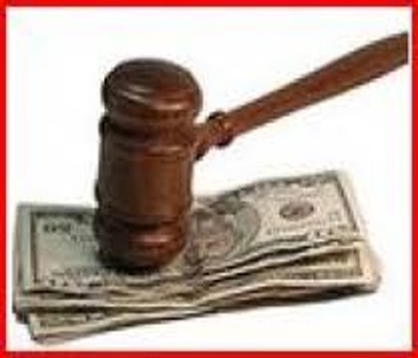
EXPANSION OF DUTY
Economic Loss​
  Construction Defects = “economic loss”​
Introduction of “Independent Duty”​
What does this mean?
© 2018 – 2021 David K. Eckberg, Betts, Patterson & Mines, P.S.
Disclaimer: Legal information is not legal advice

Slide 9

LIMITED IMMUNITY FROM TORT SUITS
RCW 51.34.035 ​
Michaels case​
What does this mean?
© 2018 – 2021 David K. Eckberg, Betts, Patterson & Mines, P.S.
Disclaimer: Legal information is not legal advice

Slide 10
DIFFERENCES BETWEEN CONTRACTOR LIABILITY AND DESIGN PROFESSIONAL LIABILITY
Design Professional​
  Negligent Design/Preparation of Plans & Specs​
  Negligent Recommendations/Advice​
  Standard of Care​
Contractor​
  Breach of Warranties-implied and express​
  Breach of Contract​
  Guarantees
© 2018 – 2021 David K. Eckberg, Betts, Patterson & Mines, P.S.
Disclaimer: Legal information is not legal advice

Slide 11
TIPS FOR MINIMIZING CLAIMS
Clear Scope of Work and Sufficient Budget​
Strong Relationships with Client and Project Team​
  Communication, Communication, Communication​
Knowledge and Proper Discharge of Responsibilities On Site​
Effective QA/QC​
Good Recordkeeping
© 2018 – 2021 David K. Eckberg, Betts, Patterson & Mines, P.S.
Disclaimer: Legal information is not legal advice

Slide 12
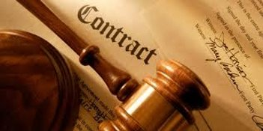
TIPS FOR MINIMIZING CLAIMS
Contractual Protections​​
  Limitation of Liability Clause​
  Indemnity from Client​
  Time Bar to Legal Actions​
  Clear statements of what work does not include
© 2018 – 2021 David K. Eckberg, Betts, Patterson & Mines, P.S.
Disclaimer: Legal information is not legal advice

Slide 13
INDEMNITY
Common area of negotiation​
Amendments to Anti-indemnity Statute:​
  (i) expressly applies to designer contracts; ​
  (ii) no duty or cost to defend; and ​
  (iii) expressly applies to “services”​
Waiver of Workers Comp immunity
© 2018 – 2021 David K. Eckberg, Betts, Patterson & Mines, P.S.
Disclaimer: Legal information is not legal advice

Slide 14
CLOSING REMARKS
Changing Construction and Legal Landscape ​
Now more than ever: Important to understand exposure and establish risk management practices to minimize this exposure​
Real concern of defensive design practice​
Alternative Project Deliveries—Remains to be seen
© 2018 – 2021 David K. Eckberg, Betts, Patterson & Mines, P.S.
Disclaimer: Legal information is not legal advice

Slide 15
One Convention Place, 701 Pike Street, Suite 1400, Seattle, WA 98101
© 2018 – 2021 David K. Eckberg, Betts, Patterson & Mines, P.S.
Disclaimer: Legal information is not legal advice

