Slide 1

CONTRACTOR v. DESIGN PROFESSIONAL
9th Annual Construction Defects: Updates & Strategies
Hosted by The Seminar Group

Slide 2
INTRODUCTION
CONTRACTOR V. DESIGN PROFESSIONAL
Background
Design Professional Liability v. Contractor Liability
Key Concepts Affecting Design Professional Liability
Closing Remarks

Slide 3
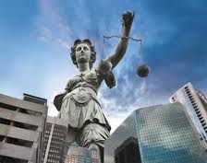
BACKGROUND
The Changing Landscape of Construction Projects
  traditional contracting
  collaborative approaches
The Changing Legal Landscape for Design Professional Liability
  Movement from Economic Loss Doctrine to Independent Duty Doctrine
  Expansion of Standard of Care
  and Duties

Slide 4

DESIGNER LIABILITY v. CONTRACTOR LIABILITY
Professional Standard of Care
Warranty
Breach of Contract
Guarantees
Designer Scope of Work Not easily defined
Contractor Work well defined with plans & specs

Slide 5
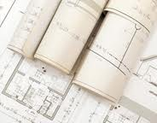
KEY CONCEPTS AFFECTING DESIGNER LIABILITY
Professional Negligence
Economic Loss / Independent Duty doctrine
Limited Immunity from Tort Suits on Construction Projects
Limitation of Liability
Indemnity

Slide 6

Professional Negligence
Professional Standard of Care—Duty of Care
Breach of Duty
Damages
Proximately caused by breach
How to prove?

Slide 7

Economic Loss/
Independent Duty Doctrine
Berschauer/Phillips
  Construction Defects = “economic loss”
Introduction of “Independent Duty”
  Eastwood/Affiliated FM
  Donatelli v. D R Strong
What does this mean?

Slide 8

Limited Immunity from Tort Suits
RCW 51.34.035
Michaels case
What does this mean?

Slide 9

Limitation of Liability
Only applies to parties in contractual privity
Clear and Unambiguous
Enforceability based on Drafting
Means of Allocating Risk/Reward

Slide 10
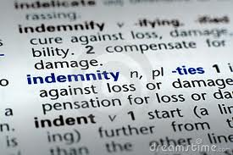
Indemnity
Common area of negotiation
Amendments to Anti-indemnity Statute:
  (i) expressly applies to designer contracts;
  (ii) no duty or cost to defend; and
  (iii) expressly applies to “services”
Waiver of Workers Comp immunity

Slide 11
CLOSING REMARKS
Changing Construction Landscape
Changing Legal Landscape
Legislative responses?
Defensive design practice
Stronger Demands on Contractual Protections

Slide 12

One Convention Place, 701 Pike Street, Suite 1400, Seattle, WA 98101

