Slide 1


Contracting Principles for Architectural Firms

Slide 2
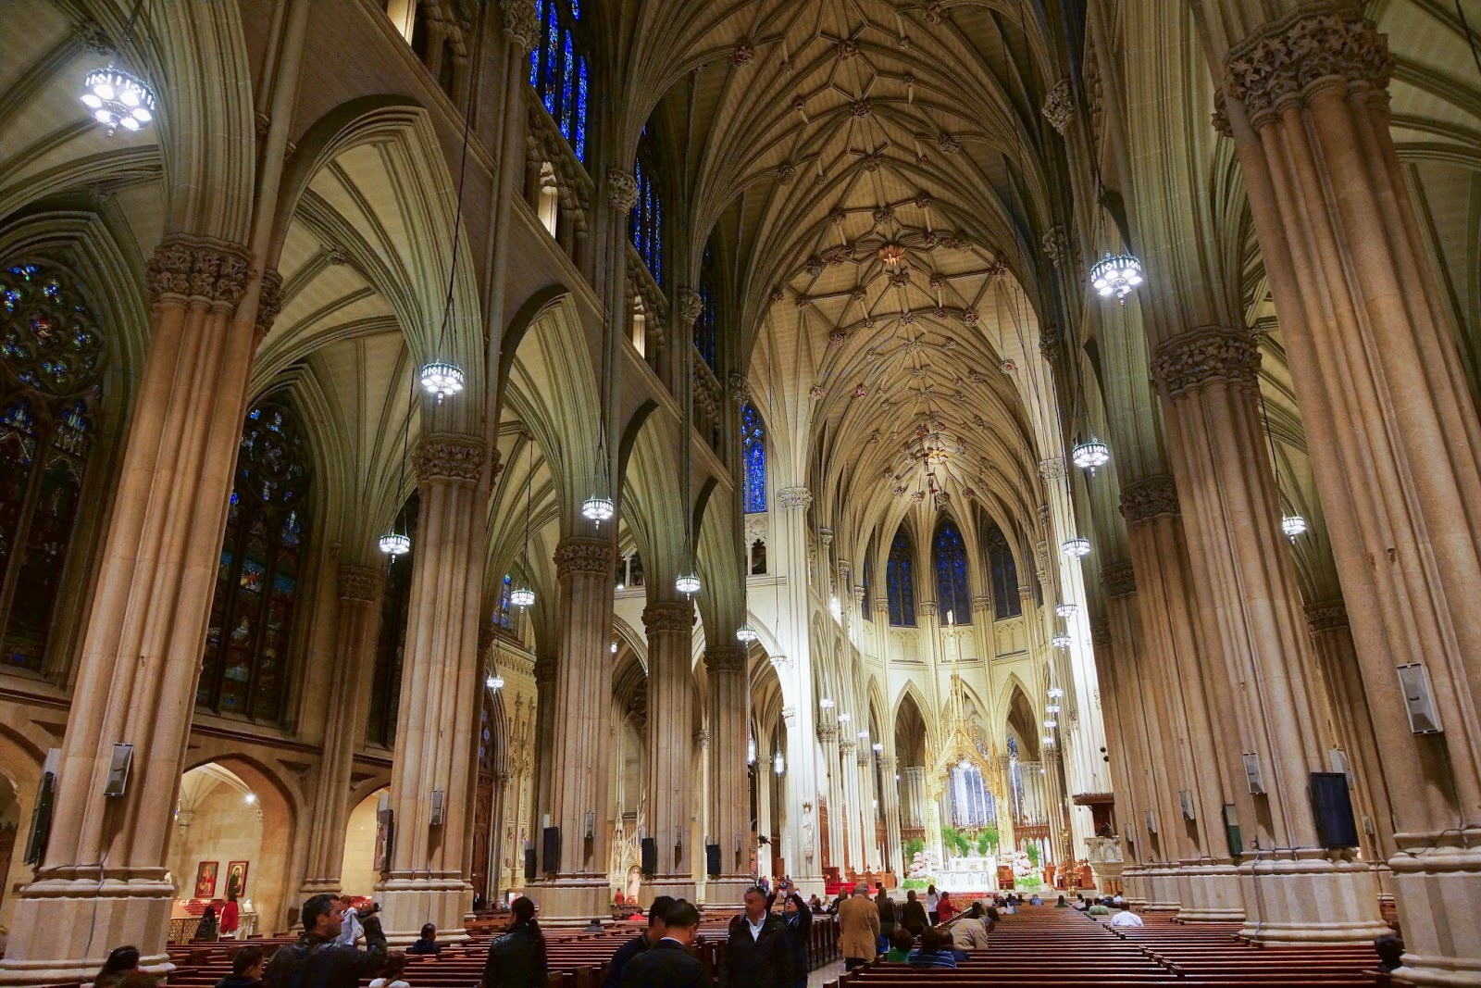

AGENDA
AIA Forms and Limitations
Key Risk-Shifting Clauses
Contract Formation Risks
Special Risks with Condo Projects
This Photo by Unknown Author is licensed under CC BY-SA-NC

Slide 3
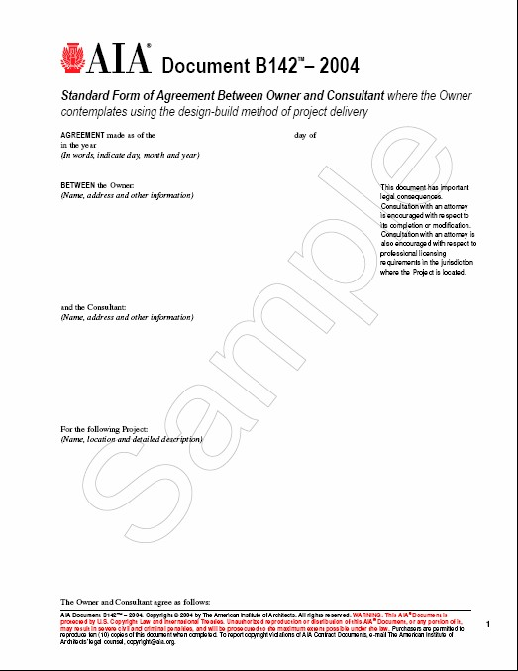

STANDARD AIA FORMS
B141 Part I (Design)
B141 Part II (Const Admin)
A201-1997 (General Conditions)
B142-2004 (Design/Build)

Slide 4

PROBLEMS WITH AIA FORMS
Missing Key Provisions:
Limitations of Liability
Indemnification
Insurance
Waivers of Warranties
BIM Issues
This Photo by Unknown Author is licensed under CC BY-SA

Slide 5


LIMITATIONS OF LIABILITY
Architect’s maximum aggregate liability responsibility to Owner … is limited to $1,000,000 for any and all work performed under the Agreement.
This is high LOL
Should not be tied insurance limits
Should be commensurate with risks/benefits
Notes:
Collins Worman has entered into several contracts in which the LOL was set at $1 million. This is an unusually high LOL.

Slide 6
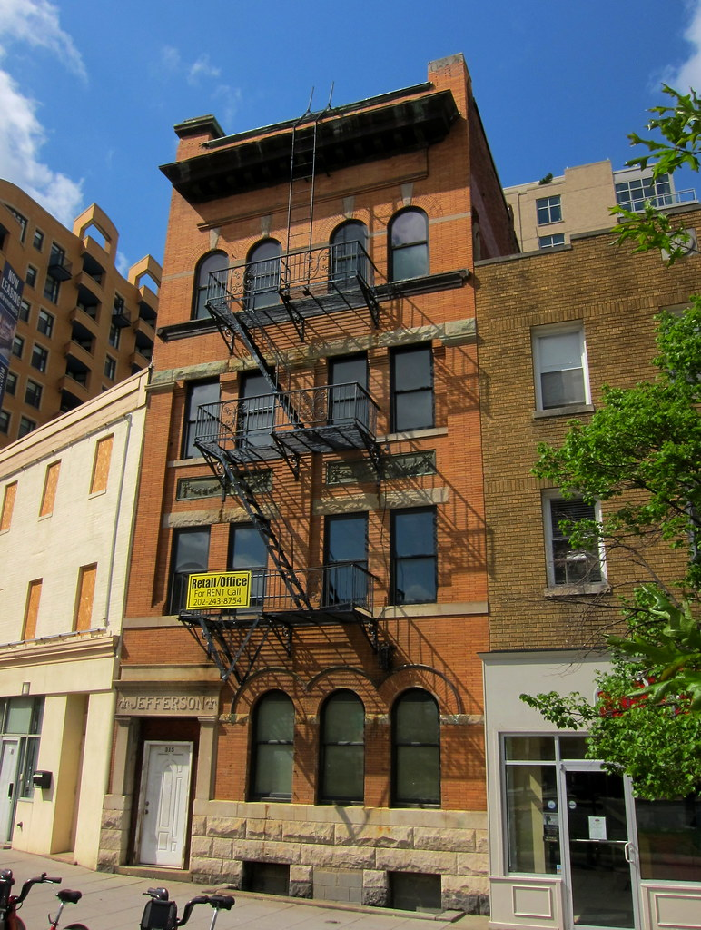

INDEMNIFICATION
Owner Indemnification of Architect
Architect Indemnification of Owner
This Photo by Unknown Author is licensed under CC BY-ND

Slide 7


OWNER INDEMNIFICATION
GOAL: Ask Owner to indemnify Architect for ANY claims EXCEPT those arising out of negligence of Architect
This Photo by Unknown Author is licensed under CC BY-SA

Slide 8
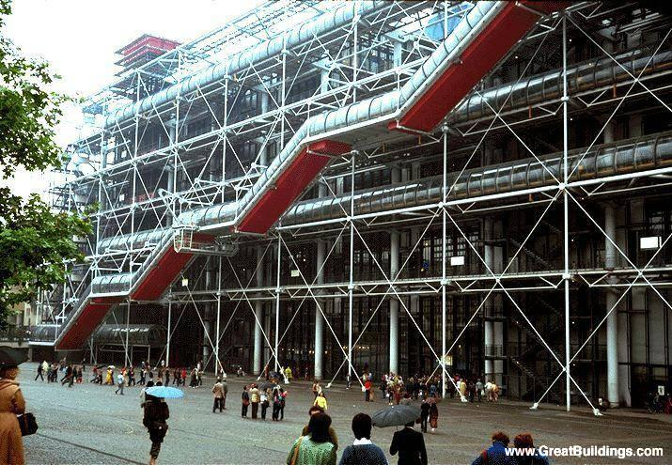

ARCHITECT INDEMNIFICATION
GOAL: Agree to indemnify only for claims arising out of negligence of Architect

Slide 9


DUTY TO DEFEND v. DUTY TO INDEMNIFY
Duty to defend: may require you to assume defense of claim against Owner
Duty to indemnify: requires payment only after finding of negligence

Slide 10


INSURANCE
Professional Liability
CGL
OCIP/CCIP
Builder’s Risk
Project Professional Liability Policy

Slide 11

PROFESSIONAL LIABILITY
Covers defense costs and claims of professional malpractice – economic loss, injuries, property damage
Does NOT cover contractual warranties or guarantees

Slide 12


COMMERCIAL GEN’L LIABILITY INSURANCE (CGL)
Covers bodily injury and property damage - Not economic loss
Excludes professional services
“Occurrence” policy vs. “Claims made” policy

Slide 13

OCIP and CCIP
It’s just a CGL Policy for Project
Does NOT cover design errors and omissions
But if high enough limits, policy may foreclose claim against designer
This Photo by Unknown Author is licensed under CC BY-SA

Slide 14
OCIP and CCIP
Do you have right to review and accept adequacy of the OCIP program?
Are policy limits adequate?
How long after project is complete does insurance remain in effect?
Are you named as an additional insured?
Is there a waiver of subrogation?
Notes:
Adequacy of policy limits:
Generally the total insurance available is not in line with construction costs. Brokers recommend
20% if concrete/steel
40% if wood frame
100% if condominiums.
Completed Operations: coverage should extend beyond completion date throughout entire statute of limitations period (3-4 years)
Additional insured: you should be an additional insured, as should every subcontractor on the job.
Waiver of Subrogation: this will prevent insurance carrier from paying out a claim by the owner and then turning around and suing for reimbursement.

Slide 15


BUILDER’S RISK
Purchased by Owner
Risks of loss to project during construction
Excludes coverage for design errors
BUT “ensuing loss” caused by design defects are covered
Architectural fees to redesign after fire or natural disaster also covered

Slide 16
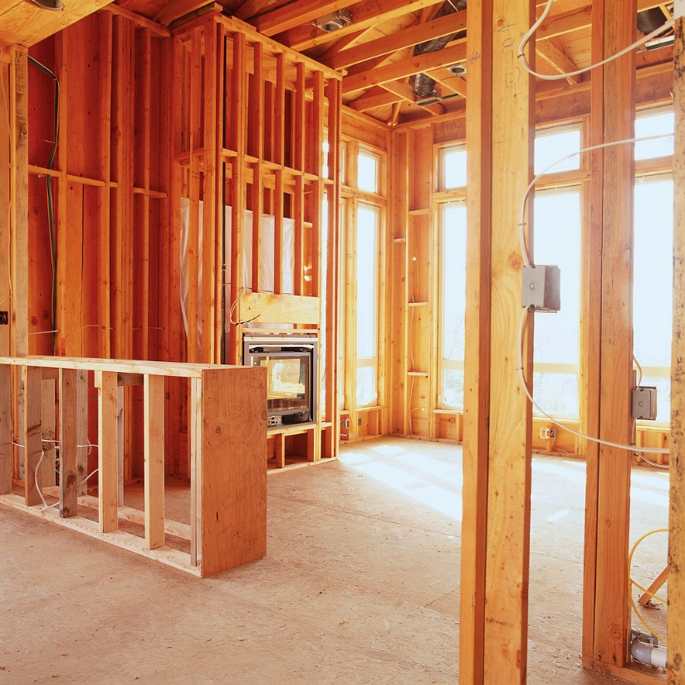

WARRANTY DISCLAIMER
Perfection not required
Warranties not required
Warranties not insurable
No control over contractor errors

Slide 17
Standard Warranty Disclaimer
ARCHITECT MAKES NO GUARANTEE OR WARRANTY, EXPRESS OR IMPLIED, IN FACT OR BY LAW, WHETHER OF MERCHANTABILITY, FITNESS FOR ANY PARTICULAR PURPOSE OR OTHERWISE, CONCERNING ANY OF THE SERVICES WHICH MAY BE FURNISHED BY ARCHITECT TO CLIENT.

Slide 18

BIM ISSUES
No standard contract
Responsibility for design if others change it?
Intellectual property?
Conflicts between BIM and paper drawings?

Slide 19
BIM AGREEMENT
Maintain contractual privity with Owner
Allocate responsibility for maintaining “master” model and accepting changes
Identify access rights to the model
Require indemnification and LOL from Owner for BIM-related claims
Require other designers to waive claims relating to BIM
Address conflicts between BIM and sealed drawings
Allocate ownership of any copyright

Slide 20

CONTRACT FORMATION
Offer/Acceptance
Counteroffers
Necessity of Signatures
Working Without Signed Agreement

Slide 21

RISK OF NO SIGNATURE
Oral authorization to start work
No signature on written agreement
Client refused to sign after work done
Court: written document not “accepted”
Parties had oral contract
But no LOL

Slide 23
GET THAT SIGNATURE
…before you start your work.

Slide 24
CONDO PROJECTS
High litigation risk
A/E insurance restrictions
Private owners with limited resources
Builders underinsured
Inadequate QA/QC

Slide 25
CONDO RISK MANAGEMENT
Careful Client Selection
Risk Analysis When Pricing Work
Good Contractual Indemnification
Appropriate LOL
OCIP With Adequate Insurance Limits
Waiver of Subrogation
Contractor Professional Liability Insurance
Thorough Contractor Due Diligence
Vigorous Construction QC Observation

Slide 26

One Convention Place, 701 Pike Street, Suite 1400, Seattle, WA 98101

