Slide 1

BUILD IT AND THEY WILL COME: ADDRESSING THE LIABILITIES OF LARGE WOOD IN RIVERS

Slide 2


INTRODUCTION/BACKGROUND
Fish & Wildlife Protection & Enhancement​
Unintended Consequences​
Increased Awareness & Concerns

Slide 3
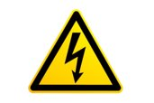
What are the Risks?
Health and Safety During Construction​
Hazards to River Users​
Hazards to Children​
Flooding of Upstream Properties​
Erosion and Damage to Downstream Properties​
Personal Injury and Property Damage when all or Part of ELJ or LWP Breaks Free

Slide 4


Who are the Potential Injured Parties?
Construction Workers/Field Personnel​
River Users​
Children​
Upstream Private Property Owners​
Downstream Private Property Owners​
Public Landowners​
Natural Environment

Slide 5

Who are the Potential Liable Parties?
Designers​
Contractors​
Landowners Where ELJ or LWP is Located​
Project Sponsors

Slide 6
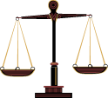
Legal Principals
Health & Safety Standards​
Negligence​
Recreational Use Immunity​
Attractive Nuisance​
Natural Watercourse Rule​
Environmental Laws

Slide 7

Health & Safety Standards
​
All employers are required to maintain a safe workplace for their employees.​
RCW 49.17.060(1)​
​
Assess Site Conditions​
Site Safety Plans

Slide 8
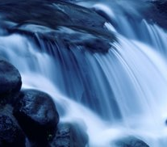
Negligence
In the Design​
In the Construction​
Need for Licensed Engineer?​
How Extensive Should Modeling Be?​
Ultimately a Standard of Care Question

Slide 9
Recreational Use Immunity
RCW 4.24.210:​
(1) Except as otherwise provided in subsection (3) or (4) of this section, any public or private landowners or others in lawful possession and control of any lands whether designated resource, rural, or urban, or water areas or channels and lands adjacent to such areas or channels, who allow members of the public to use them for the purposes of outdoor recreation, which term includes, but is not limited to, . . . fishing, camping, picnicking, swimming, hiking, . . . clam digging, . . . boating, nature study, winter or water sports, viewing or enjoying historical, archaeological, scenic, or scientific sites, without charging a fee of any kind therefore, shall not be liable for unintentional injuries to such users.

Slide 10

Recreational Use Immunity (cont.)
RCW 4.24.210:​
…​
(2) Except as otherwise provided in subsection (3) or (4) of this section, any public or private landowner or others in lawful possession and control of any lands whether rural or urban, or water areas or channels and lands adjacent to such areas or channels, who offer or allow such land to be used for purposes of a fish or wildlife cooperative project, or allow access to such land for cleanup of litter or other solid waste, shall not be liable for unintentional injuries to any volunteer group or to any other users. . . .

Slide 11
Recreational Use Immunity (cont.)
RCW 4.24.210:​
…​
(4) Nothing in this section shall prevent the liability of a landowner or others in lawful possession and control for injuries sustained to users by reason of a known dangerous artificial latent condition for which warning signs have not been conspicuously posted. . . . Nothing in RCW 4.24.200 and this section limits or expands in any way the doctrine of attractive nuisance. . . .

Slide 12
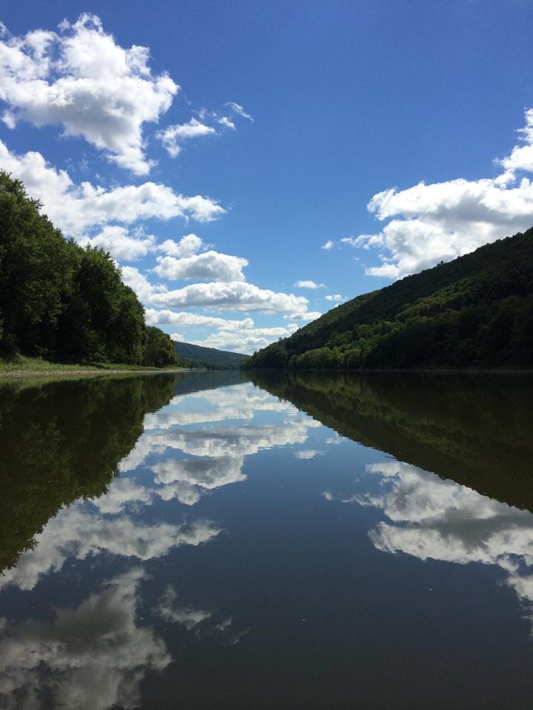
Known, Dangerous, Artificial, Latent Condition
Known​
  Actual Knowledge by Landowner​
Dangerous​
  Unreasonable Risk of Harm​
Artificial​
  Man Made​
Latent​
  Not Readily Apparent​
Fish & Wildlife Cooperative Projects
This Photo by Unknown Author is licensed under CC BY-SA-NC

Slide 13
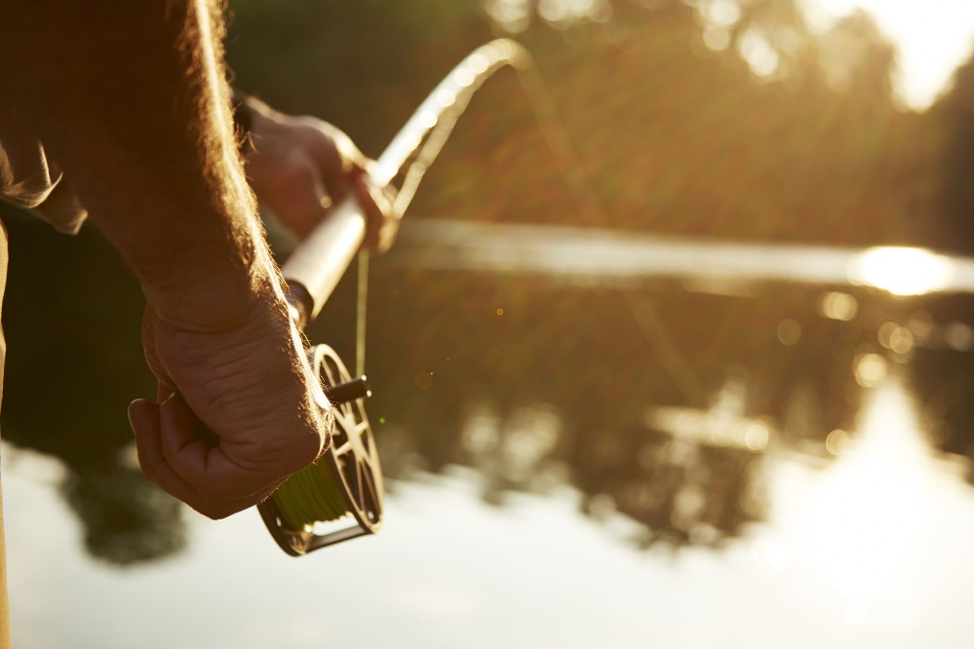
In Perspective
Immunity Only for Landowner​
Need for Warning Signs

Slide 14
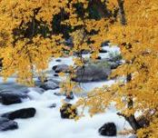
Attractive Nuisance
Must be Dangerous​
Must be Attracting/Alluring​
Child Incapable of Comprehending Danger​
Condition Left Unguarded​
Reasonable to Prevent Access​
  Without Obstructing Purpose

Slide 15

Natural Watercourse Rule
Early 1990’s​
Entitled to Allow Stream to Flow in Natural Watercourse Next to Land​
“Natural” means time when right is exercised​
Subject to Appropriation Water Rights

Slide 16
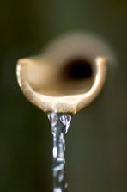
Environmental Laws
NEPA/SEPA​
Clean Water Act​
Critical Areas​
Flood Plain Restrictions​
State Forest Practices Act​
Local Laws

Slide 17
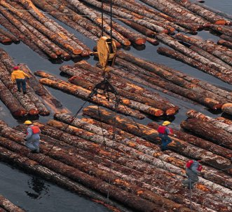
Specific Observations
“Stable” v. “Unstable” Installations​
Permitting​
Water Rights

Slide 18

Mitigating the Risk
Quality Design/Construction Team​
Planning for Health & Safety Risks​
Warnings! Warnings! Warnings!​
  In Specifications​
  Signs on River​
  Affected Landowners

Slide 19
Mitigating the Risk
Opportunities to Avoid ELJ or LWP​
Monitoring Maintenance & Repair​
Contractual Risk Allocation

Slide 20
One Convention Place, 701 Pike Street, Suite 1400, Seattle, WA 98101

