Slide 1

CONTRACTING FOR GREEN/SUSTAINABLE BUILDING PROJECTS
Beyond the Green Dream:
Facing the Reality of Green Building Compliance
The American Institute of Architects (AIA)
David K. Eckberg

Slide 2
WHAT ARE THE PRIMARY RISKS UNIQUE TO GREEN/SUSTAINABLE CONSTRUCTION?
Special Qualifications of Designer/Contractor and other Project Participants
Unrealistic or Unreasonable Owner Expectations
Contractual Terms that Can Heighten “Negligence Based” Standard of Care

Slide 3
WHAT ARE THE PRIMARY RISKS UNIQUE TO GREEN/SUSTAINABLE CONSTRUCTION?
Reliance on Third Party Entity For Meeting Goals
Certifications
New Materials, Processes, Practices

Slide 4
WHAT ARE THE PRIMARY RISKS UNIQUE TO GREEN/SUSTAINABLE CONSTRUCTION?
Potential for Significant Consequential Damages
Untested IPD type Contractual Mechanisms
Unclear/Conflicting Codes

Slide 5
WHAT ARE THE PRIMARY RISKS UNIQUE TO GREEN/SUSTAINABLE CONSTRUCTION?
Reliance on Operation & Maintenance to Meet Goals
Lack of Legal Precedent

Slide 6
CONTRACTING MECHANISMS
Traditional
OWNER
Designer Contractor

Slide 7
CONTRACTING MECHANISMS
Design-Build
OWNER
Designer/Contractor
Contractor/Designer

Slide 8
CONTRACTING MECHANISMS
Integrated Project Delivery
DESIGNER OWNER CONTRACTOR
Subconsultants/Subcontractors

Slide 9
IMPORTANT CONTRACT TERMS
Disclaimer for Change in Plan
“The Architect shall use reasonable care consistent with the foregoing standard in interpreting and designing in accordance with LEED. The Architect shall not be responsible for Contractor’s failure to adhere to the Contract Documents and any applicable laws, codes and regulations incorporated therein, nor for any changes to the design made by the Owner without the direct participation and written approval of the Architect.”

Slide 10
IMPORTANT CONTRACT TERMS
Certification v. Standard of Care
“The LEED Green Building Rating System and other similar environmental guidelines (collectively “LEED”) utilize certain design and usability recommendations on a project in order to promote an environmentally friendly and energy efficient facility. In addressing these guidelines, the Architect shall perform its services consistent with the professional skill and care ordinarily provided by architects practicing in the same or similar locality under the same or similar circumstances. The Owner acknowledges and understands, however, that LEED is subject to various and possibly contradictory interpretations. Furthermore, compliance may involve factors beyond the control of the Architect including, but not limited to, the Owners’ use and operation of the completed project. Therefore, the Architect does not warrant or represent that the Project will actually achieve LEED certification.”

Slide 11
IMPORTANT CONTRACT TERMS
Third Party Informed Consent
“If the Owner’s program includes any level of LEED®, Green Building Rating System and other similar environmental guidelines (collectively “LEED”), the Owner recognizes that the achievement of such certification is subject to third parties over whom the Architect has no control, and may require the cooperation of the Owner, the Contractor and others. The Owner acknowledges and understands LEED is subject to various and possibly contradictory interpretations. Therefore, the parties agree that if LEED certification is a stated goad of the Owner, the Architect shall use reasonable care in its design to achieve the same but makes no warranty or guarantee that the Project, when completed, will actually achieve LEED certification. In addition, the Owner acknowledges that its desire to achieve LEED may impact the available design and product options and may impact the overall cost, schedule and performance of the completed project. The Owner has accepted these potential impacts in the recognition of the importance it has placed on the values of a LEED building. In addition from time to time, the Architect may request the Owner to sign a “Client Waiver and Informed Consent to use Experimental Green Products.” Attached to this Agreement as Exhibit A is a sample of this waiver and informed consent form.”

Slide 12
IMPORTANT CONTRACT TERMS
Energy Usage Goals
“If the Owner’s program includes goals or requirements for Project energy usage, the Owner agrees to confirm the energy goals and usage in writing to the Architect. The Owner recognizes that the achievement of such goals or requirements is subject to operational and maintenance activities and decisions over which the Architect has no control. Furthermore, continued LEED compliance may involve factors beyond the control of the Architect including, but not limited to, the Owner’s use and operation of the completed project. Therefore, the parties agree that the Architect shall use reasonable care in its design to achieve the energy usage goals or requirements but makes no warranty or guarantee regarding actual energy usage.”

Slide 13
IMPORTANT CONTRACT TERMS
Limitation of Liability
“To the fullest extent permitted by law, the total liability in the aggregate, of Architect and Architect’s officers, directors, employees, agents, and independent professional associates, and any of them, to Owner and any one claiming by, through or under Owner, for any and all injuries, claims, losses, expenses, or damages whatsoever arising out of or in any way related to Architect’s services, the project, or this Agreement, from any cause or causes whatsoever, including but not limited to, the negligence, errors, omissions, strict liability, breach of contract, misrepresentation, or breach of warranty of Architect or Architect’s officers, directors, employees, agents or independent professional associates, or any of them, shall not exceed the total compensation received by Architect under this Agreement.”

Slide 14
IMPORTANT CONTRACT TERMS
Waiver of Consequential Damages
“The Architect and the Owner waive consequential damages, including but not limited to damages for loss of profits, loss of revenues, loss of business and of business opportunities, reduced rental or market values, increased insurance costs, increased energy, water and other operational costs, unrealized tax incentives, credits, deductions and/or rebates, for claims, disputes or other matters in question arising out of or relating to this Agreement. The Owner and the Architect agree to require a similar provision in all contracts with contractors, subcontractors, subconsultant, vendors, and other entities involved in this Project to carry out the intent of this provision.”

Slide 15
PUBLIC V. PRIVATE CONTRACTING
Government Goals and Expectations v. Private Financial Incentives
  Goals as Non-negotiable Requirements
  Cost Considerations
  Tax Credits
  Other Financial Incentives

Slide 16
PUBLIC V. PRIVATE CONTRACTING
Government Contracting and Public Procurement Processes
  Quality Based Selection
  Competitive Bidding
Federal Acquisition Regulations

Slide 17
PUBLIC V. PRIVATE CONTRACTING
Flexibility in Use of Contract Mechanisms and Contract Terms
  IPD
  Risk/Reward Allocation

Slide 18
COMMENTS ON LEED CERTIFICATION PROCESS

Slide 19
Federal Requirements
All projects must meet energy efficiency and sustainable design objectives included in:
  Energy Policy Act of 2005
  Executive Order 13423: Strengthening Federal Environmental, Energy, and Transportation Management (2007)
    includes the Guiding Principles for Federal Leadership in High-Performance and Sustainable Buildings
  Energy Independence and Security Act of 2007
  Executive Order 13514: Federal Leadership in Environmental, Energy, and Economic Performance (2009)

Slide 20
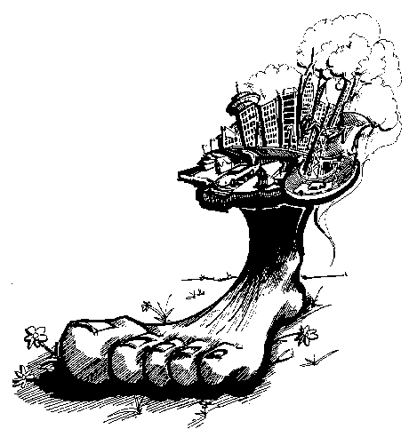
Executive Order 13514
Federal Leadership in Environmental, Energy & Economic Performance
Measure, Manage, and Reduce Greenhouse Gas Emissions toward Agency-defined Targets
Scopes 1 & 2 and Scope 3 Targets
26% Water Reduction by 2020
50% Waste Diversion
Net Zero by 2020
Transit-oriented Design
Fleet & Fuel Reductions
Green Procurement

Slide 21

The Guiding Principles for High-Performance and Sustainable Buildings
Use
Integrated Design
Protect and
Conserve Water
Enhance Indoor Environmental
Quality
Reduce Environmental Impact of Materials
Optimize Energy Performance

Slide 22
Evolving Market
ANSI/ASHRAE/USGBC/IES Standard 189.1-2011: Standard for the Design of High-Performance Green Buildings
International Green Construction Code (IgCC) 2012
Living Building Challenge
LEED v4
www.gsa.gov/gbcertificationreview

Slide 23
U.S. General Services Administration
. . . to provide innovative solutions for our customers in support of their missions . . .
GSA Mission
GSA will eliminate its impact on the natural environment and use its governmentwide influence to reduce the environmental impact of the federal government.
GSA Sustainability Plan

Slide 24

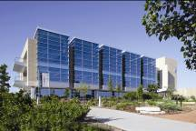

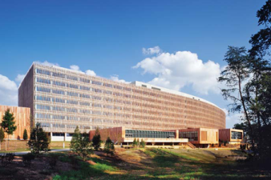
GSA Public Buildings Service
8,603 owned and leased assets
354 million RSF across the U.S.
House 1 million federal employees
Landlord for over 400 different federal agencies, bureaus and commissions
Morse U.S. Courthouse
Eugene, OR
NPS
Omaha NE
EPA Science and Technology
Kansas City, KS
U.S. Census Bureau
Suitland, MD

Slide 25
Request for Lease Proposals (RLP)
Lease Construction
  Meet the Same Requirements as for Federal Construction
Leased Space
  Green Lease Clauses For Fit-out
  Designed To Achieve The Guiding Principles for Existing Buildings
Energy Star
  Federal Leases Over 10,000 SF, With A Few Exceptions, Must Be In ENERGY STAR® Labeled Buildings.
www.gsa.gov/leasing

Slide 26
Green Lease Clauses/Lease Sections
RLP
EISA
Bldg. + Site Info.
Recycled Content Products
Env. Preferable Bldg. Prod.
Existing Fit-Out, Salvaged
Construction Waste Mgmt.
Wood Products
Adhesives & Sealants
Vestibules
E I S A
Ceilings
Insulation: Thermal, Acoustic
Painting
Toilet Rooms
Ventilation
Lighting: Interior + Parking
Energy Effic. for New Constrc.
L E E D
Indoor Air Qual. During Const.
Systems Commissioning
Plumb.Fixtrs.: Water Consrvtn.
Green Lease Submittals
Con
CONSTRUCTION STANDARDS + SHELL
L E A S E
TENANT IMPROVEMENTS
Doors: Hardware
Wall Finishes
Painting
Floor Coverings
Heating & Air Conditioning
Lighting: Interior + Parking
Heating & Air Conditioning
Janitorial Services
Selection of Cleaning Products
Selection of Paper Products
Landscaping
Recycling
Indoor Air Quality
Mold
Utility Consumption Reporting
UTILITIES, SERVICES, OBLIGATIONS DURING LEASE TERM
Notes:
Illustrates the green lease clauses for the Standard model lease within each category of the lease - - the Shell , the T.I.s, and the Utilities/Obligations

Slide 27
Acquisition Strategy
Lowest cost technically acceptable
  Lowest cost
  Technically acceptable = satisfies RLP requirements
Best value tradeoff
  May not be lowest offer
  Non-monetary award factors considered (e.g. design, experience, past performance, location)

Slide 28
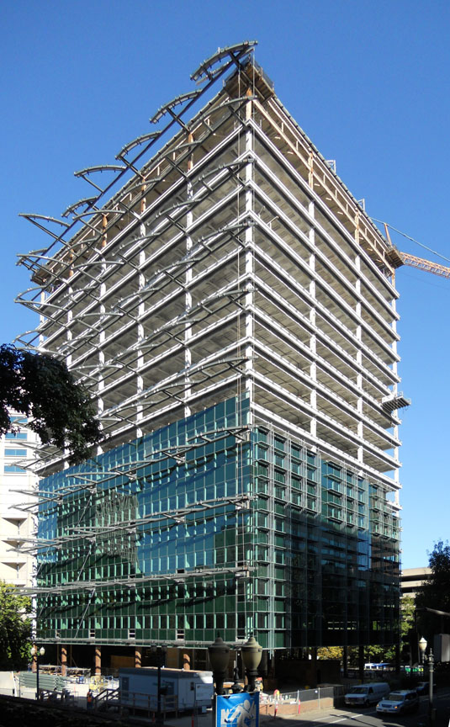

American Recovery & Reinvestment Act
$5.5 Billion
$4.5 Billion for Existing Buildings
261 Projects; 50 States, 2 Territories & DC
Jobs
High-Performance Green Buildings

Slide 29
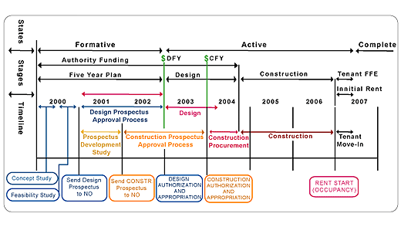
Old Process

Slide 30
Moving to Performance-based Contracting
Encouraging innovation and expecting excellence in performance
Focus on desired outcome
Describe what you will achieve, not how you achieve it

Slide 31
Facilities Standards for the Public Buildings Service (P100)
Performance Criteria
A Means to Verify Performance
A Means to hold parties Responsible for Performance

Slide 32
Pentagon Renovation
Integrated product teams
  co-location with contractor
Contractors are responsible for figuring out how to do it
Quarterly award fee
  full attainment must be possible
“If you want success, hire people that can deliver”

Slide 33
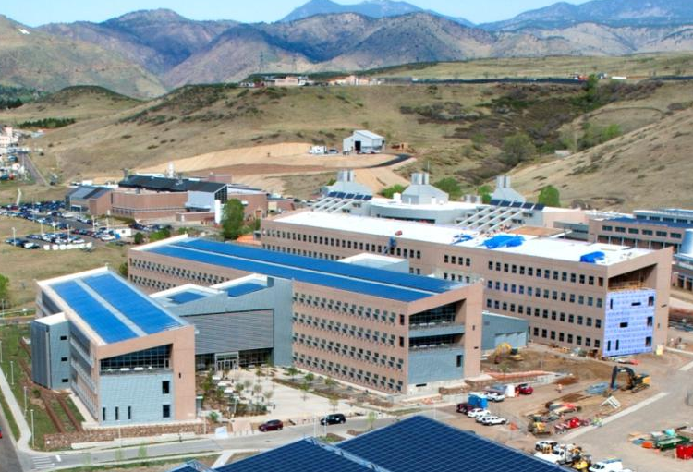
NREL Research Support Facility
800 people
220,000 ft²
25 kBtu/ft²
50% energy savings
$259/ft²
LEED Platinum
Replicable
  process
  technologies
  cost
Site, source, carbon, cost ZEB
  Includes plugs loads and datacenter
Design/Build Process with required energy goals
  $64 Million Firm Fixed Price
www.nrel.gov/rsf

Slide 34
MISSION CRITICAL
Attain safe work performance/Safe Design Practices
LEED Platinum
Energy Star “Plus”
HIGHLY DESIRABLE
800 staff Capacity
25kBTU/sf/year
Architectural integrity
Honor future staff needs
Measurable ASHRAE 90.1
Support culture and amenities
Expandable building
Ergonomics
Flexible workspace
Support future technologies
Documentation to produce a “How to” manual
“PR” campaign implemented in real-time
Allow secure collaboration with outsiders
Building information modeling
Substantial Completion by 2010
RFP Objectives Checklist
IF POSSIBLE
Net Zero/design approach
Most energy efficient building in the world
LEED Platinum Plus
ASHRAE 90.1 + 50%
Visual displays of current energy efficiency
Support public tours
Achieve national and global recognition and awards
Support personnel turnover
RFP also required maximum use of natural ventilation and 90% of floor space fully daylit
Full Performance RFP No drawings in RFP = No change orders!

Slide 35
Energy Savings Performance Contract (ESPC)
BEFORE PERFORMANCE CONTRACT
PAYMENTS
TO
UTILITY
PROVIDERS
AFTER PERFORMANCE CONTRACT
SAVINGS
IN EXCESS
SERVICE
PAYMENTS
GUARANTEED PORTION
PAYMENTS
TO
FINANCING
INSTITUTION
PAYMENTS
TO
UTILITY
PROVIDERS
Zero or positive net impact on existing budgets.

Slide 36
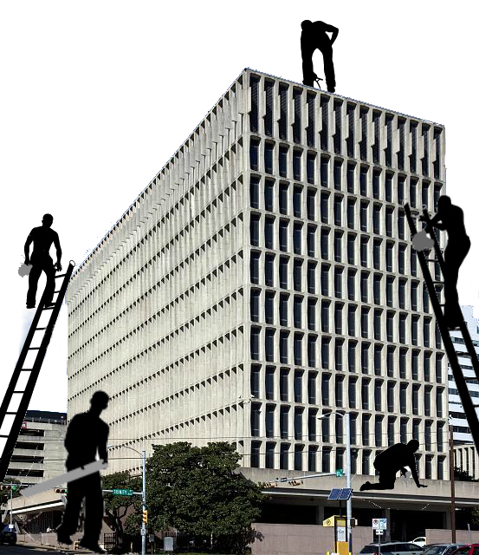
Deep Energy Retrofit
Process Differentiators
  Building Owner Involvement
  Integrative Design
  Advanced Auditing, Modeling, LCCA
  Ongoing M&V
  Occupant Engagement
Results:
  Larger Energy Savings
  Improved Project Economics

Slide 37
What’s Next?
Change in Procurement Practice
Change in Budget Practice
Change in Measurement
Criteria for Selecting Vendors
Performance Contracting by Team Negotiation
Change in Fee Structures
Integration with Buildings Operations, Not Just at the Hand-Off, but for Years

Slide 38
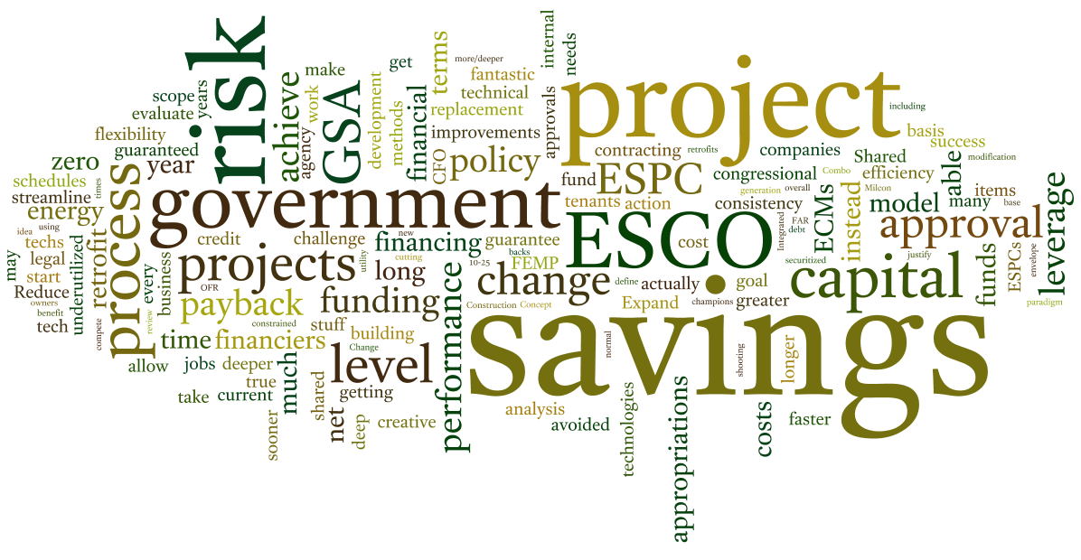
Key Lessons
Need better up front planning
An integrated design process is critical
The importance of relationships

Slide 39
References
IndustryRelations@gsa.gov
  1-866-PBS-VEND (727-8363)
Federal Business Opportunities
  FedBizOpps
  www.fbo.gov
Acquisition Central
  www.acquisition.gov
GSA Greening Federal Buildings
  www.gsa.gov/greenbuilding

Slide 40

QUESTIONS?

